Slide 1

POORNIMA COLLEGE OF ENGINEERING DEPARTMENT OF INFORMATION TECHNOLOGY Poornima payment with android
Session (2018-19)
Group Number :- VIII Guide : Mr.Shirish Nagar

Slide 2
Details of Team members
Aditya Laxkar
Contact no. : 8386866231
Email id : 2015pceitaditya003@poornima.org
Tushar Gupta
Contact no. :7427881503
Email id : 2015pceittushar@poornima.org

Slide 3
Reference of tools and technology used
Tools:
Android Studio
Firebase Services for database.
Technologies:
Kotlin Programming language
Android GUI modules

Slide 4
Project Title And Area Of Project
Project Title:
POORNIMA PAYMENT
Area Of Project:
Android and kotlin Programming language

Slide 5
Description of the area and significance of the project
Android based mobile applications are currently on-going and is having a wide range of usage. one of the best use cases of mobile based application are online payment , food delivery, cab booking. Here in this project Android is the main area of development.
The next area that is being covered is Java programming language. Android clubbed with java programming is the thing of current phases as mobile apps helps in designing an environment of interconnected world . As the devices are widely used now a days and we prefer using mobile applications for things like booking cab , online food ordering, online billing payments or any other payment mode is mobile application.
This project is being designed for e-payment purpose but with a little change it can be implemented in big industries as well.

Slide 6
Reference with brief description of tools and technology used
System interfacing part will be developed in Java programming language and the interface for interaction with the user will be Mobile based UI designed using android activities.

Slide 7
Synopsis
Objective vision:
Making E-payment application that will in turn reduce paper currency and one step
closer towards digital India
Users of the system
Administrator
Sub Users like college students and staff.
Optional features
Sending reports through E-mail
Transaction history of user in their personal profile.
Weekly Report generated inside mobile application for every user in their personal profile.
User interface priorities
Web based control panel
Easy User Interface
Easy Navigation between activities

Slide 8
Functional Requirements
A system for an Admin who can have control over all activities of user and all activities like editing in menu items or payment methods.
College students and faculties can register the details to the Application.
The facility to see available services in the Campus.
Users receive Notifications alerts regarding the updating in menu and offers.
The facility to check whether the things are available or not.
Admin can view the report of the users to improve the system.
Users can report suggestions/complaints in the applications.{User reviews}
Admin can monitor every activity which is performed by system.
Store user payment details and allow for future updating of payment option.

Slide 9
Non functional Requirements
The application should be able to handle application’s servers should perform load balancing efficiently. Multiple (ex: 1000) Transaction requests simultaneously.
The application’s servers should perform load balancing efficiently.
Application should be lightweight and give quick response.
The user’s data should be kept safe.
The application should be platform independent.

Slide 10
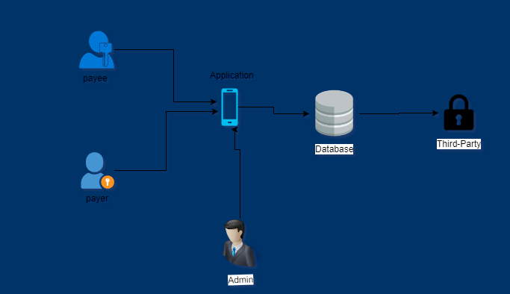
System Architecture

Slide 11
Final deliverable
1. Online or offline help to above said users, Application deployment executive and developer
2. Application archive (.war/.ear) with source code
3. Database backup and DDL Script
4. Complete Source code.

